Slide 1
Technical Report of Adaptive Neural Control For Non-Strict-Feedback Nonlinear Systems With Input Delay
Vishnu Mandala – 119452608
Rohit Sai Suresh - 119283684

Slide 2
Introduction
Welcome and Overview: We are thrilled to share our journey into the realm of adaptive neural control, focusing on the challenging area of non-strict-feedback nonlinear systems with input delay.
Our Inspiration: Our work is inspired by the innovative research by Huanqing Wang, Siwen Liu, and Xuebo Yang. We have taken their foundational work as a stepping stone to explore further and deepen the understanding in this field.
Scope of Our Work: Our project involved a detailed replication and extension of the proposed controller design, executed through sophisticated MATLAB simulations. This allowed us to delve into the intricate aspects of non-strict-feedback systems and their control mechanisms.

Slide 3
Motivation
The Complexity Challenge: In the rapidly evolving field of control systems and robotics, one of the most daunting challenges is managing complex nonlinear systems. These systems, often characterized by unpredictable behaviors and difficult modeling scenarios, represent a significant hurdle in both theoretical and practical aspects of control engineering.
Focus on Non-Strict-Feedback Systems: Non-strict-feedback nonlinear systems, especially, pose a unique challenge. Their structural and behavioral intricacies make traditional control approaches less effective, necessitating the development of more advanced methods.

Slide 4
Innovation by Original Authors
The paper "Adaptive Neural Control for Non-Strict-Feedback Nonlinear Systems with Input Delay" represents an important moment in control system theory. It tackles the formidable challenge of non-strict-feedback systems with a novel approach, blending traditional methods with advanced neural network techniques.
Integration of Neural Networks and Backstepping Techniques: The innovation lies in the ingenious use of neural networks, particularly Gaussian radial basis functions, combined with backstepping techniques. This hybrid approach allows for a more precise approximation of nonlinearities and better handling of system uncertainties.

Slide 5
Working and Theory of Adaptive Neural Control
Controller Design for Non-Strict-Feedback Systems:
Challenge Addressed: The research focuses on designing controllers for non-strict-feedback systems with input delay, a notably complex issue in control systems.
Utilization of Auxiliary Systems: To tackle the difficulties arising from input delays, an auxiliary system is employed. This innovative approach is pivotal in managing the challenges posed by the input delays in these systems​​.

Slide 6
Working and Theory of Adaptive Neural Control
Integration of Backstepping and Neural Control:
Adaptive Control Architecture: The approach leverages the adaptive control architecture developed with neural networks (specifically Gaussian radial basis functions) and fuzzy logic systems. This method is renowned for its ability to approximate nonlinearities not directly analyzable.
Backstepping Technique: The combination of backstepping techniques with adaptive fuzzy/neural control is applied to control nonlinear systems without needing to satisfy matching conditions. This integration enhances the controller's capability to manage complex system behaviors

Slide 7
Working and Theory of Adaptive Neural Control
Contributions of the Research:
Extension to Non-Strict-Feedback Systems: A significant contribution of this research is extending adaptive neural control, a primary method for handling nonlinear control problems, to a class of nonlinear systems with input delay and non-strict feedback form.
Simplification of Controller Design: The use of radial basis functions in the neural network simplifies the process of dealing with the non-strict-feedback structure, effectively reducing the controller's design complexity
Outcome:
Semi-Global Uniform Ultimate Boundedness: The state-feedback stabilization controller developed through this methodology ensures that the variables within the closed-loop system are semi-globally uniformly ultimately bounded, maintaining system stability within a specified range around the origin

Slide 8
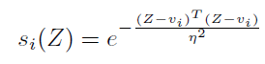
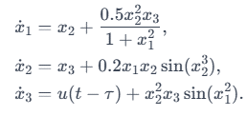
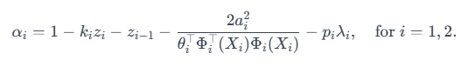
Formulas and Technical Details
Main Equation:
System Dynamics:
The system is characterized by the following state equations:
These equations represent the nonlinear system dynamics, including a delay in the control input u(t−τ)

Slide 9
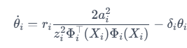
Formulas and Technical Details
Virtual Control Law (αi​):
The virtual control inputs are defined as:
αi are intermediate control actions used in the backstepping design, incorporating system states (zi), adaptive parameters (θi), and the radial basis function (Φi(Xi))
Adaptive Law (θ˙i​):
The adaptive laws for updating the neural network parameters are given by:
These laws adjust the parameters θi of the neural network based on the state information Xi and control errors zi, ensuring the system adapts to uncertainties and nonlinearities.

Slide 10
Simulation Parameters
The simulation was carried out with the following design parameters and initial conditions:
k1 = k2 = 2, k3 = 6
ai = pi = ri = δi = 1, i = 1, 2, 3
τ = 1.5s
Initial conditions for the system states and adaptive parameters were set as
[x1(0), x2(0), x3(0), λ1(0), λ2(0), λ3(0)]T =
[0.1, 0.1, 0.1, 0, 0, 0]T and [ˆθ1(0), ˆθ2(0), ˆθ3(0)] =
[0, 0, 0].
To account for the missing parameters in the original paper, the following assumptions were made based on the references
The width of the Gaussian function, η, was taken to be 2.
The center of the receptive field, vi, was assumed to be 0.1.
The number of nodes in the neural network, l, was set to 3.

Slide 11
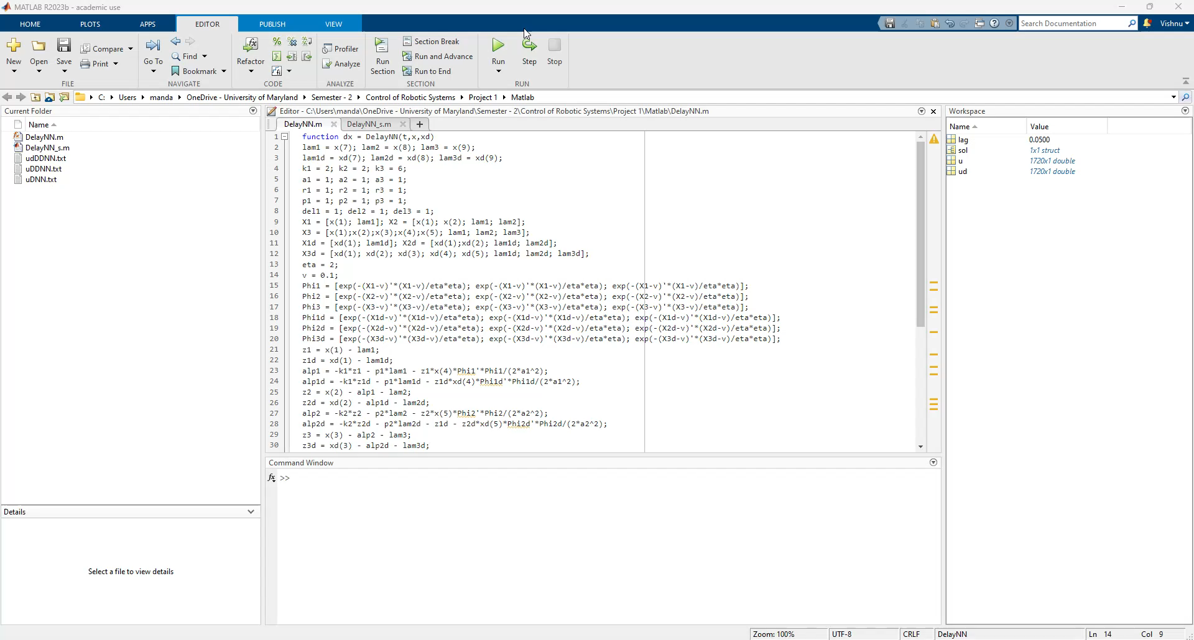
Simulation Video

Slide 12
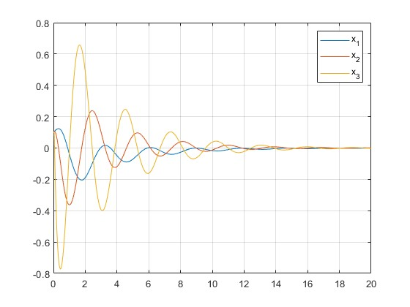
Simulation Results – Figure 1
State Trajectories (x1, x2, and x3)
This figure displays the state trajectories of the system variables x1​, x2​, and x3​.
The trajectories demonstrate how each state variable evolves over time under the control scheme.
All three state trajectories display initial transient behaviors before settling into a stable pattern.
x1​ and x2​ show more pronounced oscillations initially, which dampen as time progresses.
x3​ exhibits a smoother transition toward stability, indicating effective control action on this state.
After around 10 seconds, all states appear to converge towards zero, suggesting that the controller is successful in stabilizing the system.

Slide 13
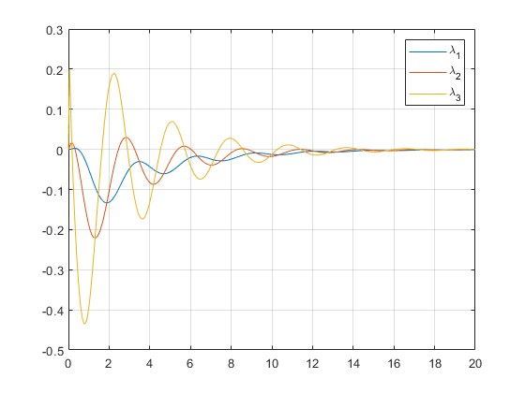
Simulation Results – Figure 2
State Trajectories of Auxiliary System (λ1, λ2, and λ3)
This figure shows the state trajectories of the auxiliary system's states λ1​, λ2​, and λ3​.
The auxiliary system is critical in handling the input delay in the control system.
The auxiliary states λ1​, λ2​, and λ3​ also show initial fluctuations which decrease over time.
The convergence of λ states toward zero implies that the auxiliary system is effectively compensating for the input delay.
The similar patterns between the λ states indicate a synchronized response of the auxiliary system to the state variables.

Slide 14
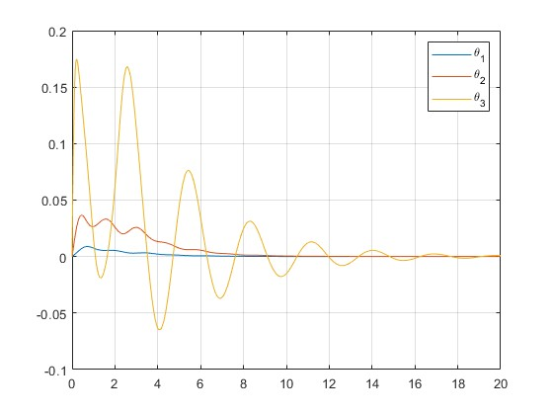
Simulation Results – Figure 3
Adaptive Laws Trajectories (θ̂1, θ̂2, and θ̂3)
This figure illustrates the trajectories of the adaptive laws, represented by θ̂1, θ̂2, and θ̂3. These adaptive laws are essential for the neural network's ability to adjust its parameters in response to system dynamics and uncertainties.
The parameters θ̂1, θ̂2, and θ̂3 display bounded behavior, with no parameter diverging, which is crucial for the system’s stability.
The adaptive laws settle into a steady state after initial larger adjustments, suggesting that the neural network is successfully adapting to the system dynamics.
The convergence of the adaptive parameters indicates that the neural controller has learned the system dynamics sufficiently to stabilize the system.

Slide 15
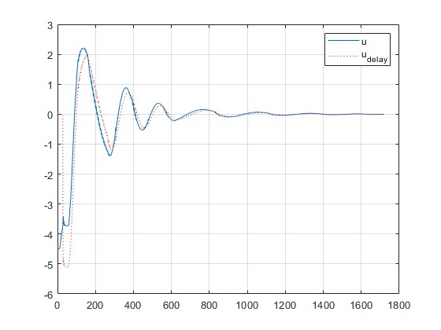
Simulation Results – Figure 4
Control Signal (u(t − τ))
Figure 4 presents the control signal u(t−τ), with a time delay τ of 1.5 seconds.
The control signal is a key output of the system, indicating how the controller responds over time to achieve desired system performance.
The control signal u(t−τ) shows a significant initial spike, which is indicative of the controller responding to initial conditions or errors.
The control effort stabilizes shortly after, maintaining bounded behavior throughout the simulation, which indicates effective control despite the delay.
The dotted line represents the control signal with the delay accounted for, and its pattern following the actual control signal shows the delay's impact is being managed.

Slide 16
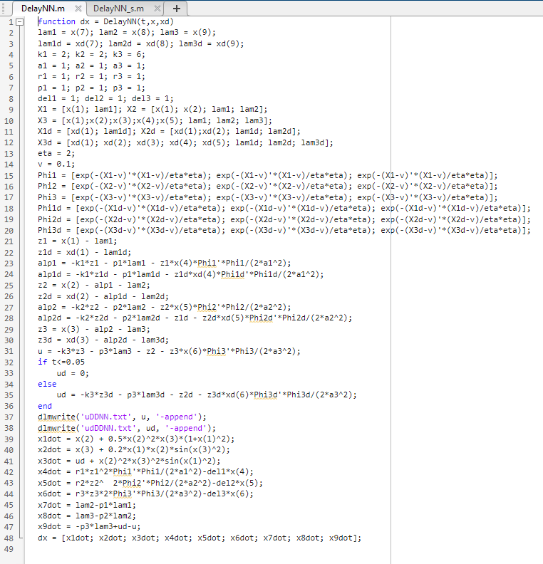
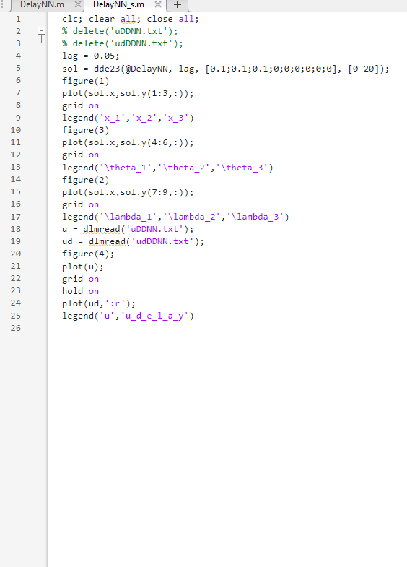
MATLAB Code

Slide 17
Discussions
Validation of Controller Design: Our simulations demonstrate that the designed controller effectively stabilizes the state variables and the auxiliary system states, even in the presence of input delays.
Bounded Adaptive Laws: The adaptive laws, which are central to the neural control strategy, remained bounded throughout the simulation. This indicates a successful adaptation of the controller to the system's nonlinearities.
Robustness against Delays: The control signal's ability to remain bounded and stable, despite the input delay, showcases the robustness of the controller design.
Implications for Real-World Systems: These results have significant implications for real-world systems where delays and nonlinearities are prevalent, offering a potential increase in performance and reliability.

Slide 18
Conclusion
Achieving Stability in Complex Systems: We have shown that adaptive neural control is an effective strategy for stabilizing non-strict-feedback nonlinear systems, addressing both complexity and input delays.
Advancing Control Theory: The methodology used in this study advances the field of control theory by providing a novel approach to a previously unaddressed class of systems.
Encountered Challenges: Despite our rigorous implementation, we faced challenges in exactly replicating the original paper's graphs, primarily due to certain unknown parameters which were not fully detailed in the original study.
Final Takeaway: The success of this control approach paves the way for more advanced and reliable control systems, which are essential for the development of sophisticated technologies in various industries.

Slide 19
Thank You

